Slide 1

Phishing awareness training
Presented By: Ghazala Sultana

Slide 2
AGENDA
What is Phishing?
Types of Phishing Attacks
Recognizing Phishing Emails
Identifying Fake Websites
Social Engineering Tactics
Real-World Examples
Prevention Tips
What to Do If You Are Attacked

Slide 3

What is Phishing?
Phishing is a cybercrime where attackers pretend to be trusted people or companies to trick users into sharing sensitive information
Example:
Fake bank emails
Fake social media login pages
Fake prize-wining messages

Slide 4
Why Do Attackers Use Phishing?
Attackers use phishing to steal:
Passwords
Credit Card Information
Bank account details
Personal information
Goal:
To gain money , access account, or commit identity theft.

Slide 5

Email Phishing
Email phishing is the most common type of phishing attack.
How it works:
A fake email is sent.
The email appear to come from a trusted source.
The victim clicks a malicious link.

Slide 6
Other types of phishing
Spear phishing
Smishing
vishing
whaling

Slide 7
How to recognize a phishing Email
Look for:
Unknow sender
Spelling mistake
Urgent requests
Suspicious links
Unexpected attachments
Never trust an email just because it looks professional.
Example of phishing Email
Subject: Your Account Will Be Locked
“Click here immediately to verify your account.”
Waring Signs:
Creates panic
Ask for personal information
Suspicious link

Slide 8
What is a Fake Website?
A fake website is designed to look like a legitimate website.
Purpose:
To trick users into entering:
Usernames
Passwords
Banking information
How to Identify Fake Websites
Check:
✔ Website URL
✔ HTTPS Security
✔ Company Contact Information
✔ Spelling Errors
✔ Website Design Quality

Slide 9
What is social engineering?
What is Social Engineering?
Social engineering is a technique where attackers manipulate people into revealing confidential information.
Instead of hacking computers,
they hack human emotions.
Common Social Engineering Tactics
Fear
"Your account will be closed."
Urgency
"Act now!"
Curiosity
"See who viewed your profile."
Rewards
"You won a free gift."

Slide 10
Real life examples
1. Fake Bank Email
Victims receive an email claiming there is suspicious activity in their account.
They click the link and enter login details.
Result:
Credentials stolen
Bank account compromised
2. Delivery Scam
Victim receives a text:
"Your package delivery failed. Click here."
After clicking:
Malware may install
Personal data may be stolen

Slide 11
Best practice
Strong Passwords
Use:
Long passwords
Uppercase and lowercase letters
Numbers
Special symbols
Example:
name@2026#Safe
Multi-Factor Authentication (MFA)
MFA adds an extra security layer.
Example:
Enter password
Enter code sent to phone
Even if attackers know your password, they cannot easily access your account.
Verify Before Clicking
Before clicking:
Check sender email
Hover over links
Visit official websites directly
Rule:
Think Before You Click

Slide 12
What To Do If You Become a Victim
Immediate Actions:
Change passwords
Enable MFA
Contact your bank
Report the incident
Recovery Steps
After an Attack:
Scan device with antivirus
Monitor accounts
Inform affected organizations
Watch for unusual activity

Slide 13
INTERACTIVE QUIZ
Question 1
What is phishing?
A. A type of computer hardware
B. A cyberattack used to steal sensitive information
C. A software update
D. A security tool
Answer: B
Question 2
Which of the following is a common sign of a phishing email?
A. Personalized greeting
B. Professional email signature
C. Urgent request for immediate action
D. Official company logo
Answer: C
Question 3
What information do attackers commonly try to steal through phishing?
A. Passwords
B. Banking details
C. Personal information
D. All of the above
Answer: D

Slide 14
INTERACTIVE QUIZ
Question 4
What should you do before clicking a link in an email?
A. Click immediately
B. Verify the sender and inspect the URL
C. Forward it to friends
D. Ignore all emails
Answer: B
Question 5
What does HTTPS indicate?
A. The website is completely safe
B. The connection is encrypted
C. The website is government-approved
D. The website cannot be fake
Answer: B
Question 6
Which attack uses text messages to trick victims?
A. Vishing
B. Spear Phishing
C. Smishing
D. Whaling
Answer: C

Slide 15
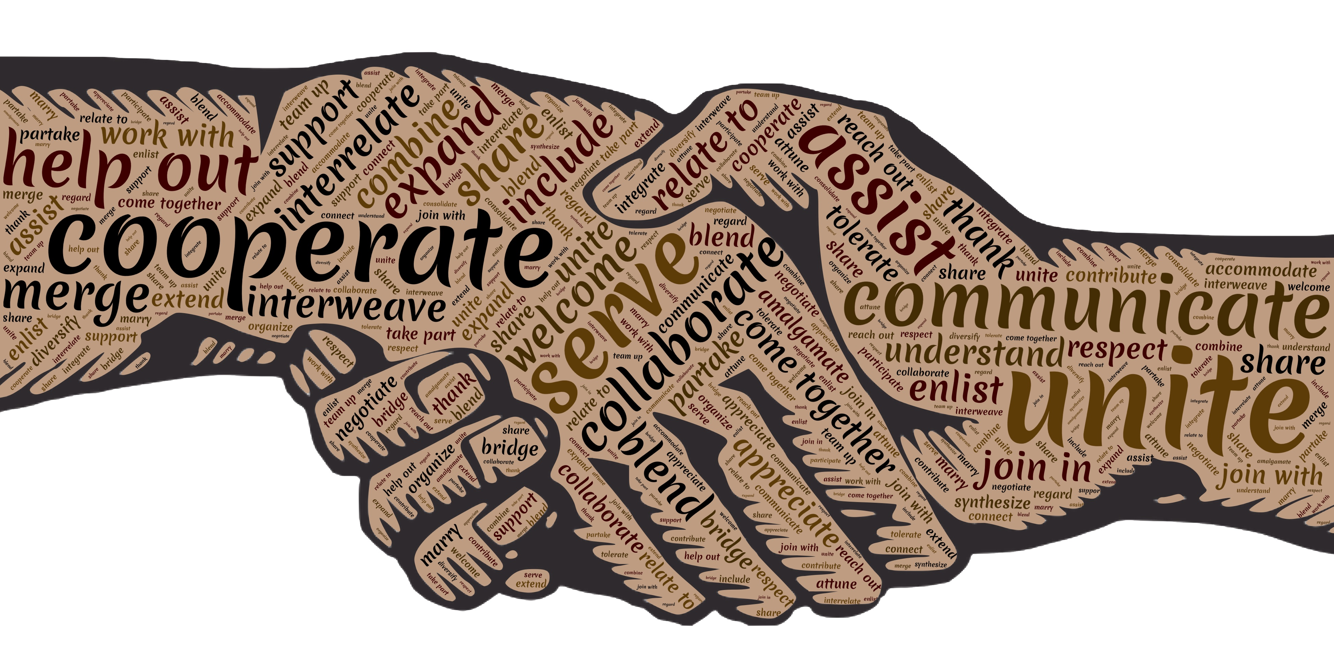
Thank You

